Slide 1
Signal Processing First
LECTURE #2
Phase & Time-Shift
Complex Exponentials
© 2003, JH McClellan & RW Schafer

Slide 2
READING ASSIGNMENTS
This Lecture:
  Chapter 2, Sects. 2-3 to 2-5
Appendix A: Complex Numbers
Appendix B: MATLAB
Next Lecture: finish Chap. 2,
  Section 2-6 to end
© 2003, JH McClellan & RW Schafer

Slide 3
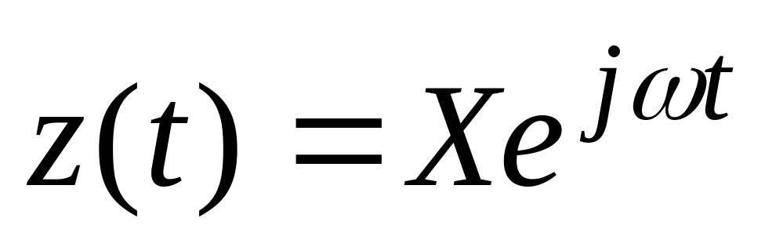
LECTURE OBJECTIVES
Define Sinusoid Formula from a plot
Relate TIME-SHIFT to PHASE
Introduce an ABSTRACTION:
  Complex Numbers represent Sinusoids
  Complex Exponential Signal
© 2003, JH McClellan & RW Schafer

Slide 4
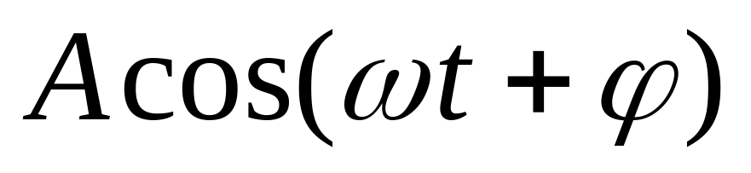


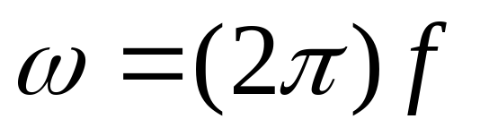

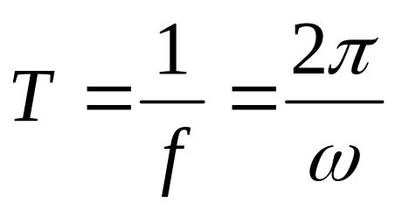
SINUSOIDAL SIGNAL
FREQUENCY
  Radians/sec
  or, Hertz (cycles/sec)
PERIOD (in sec)
AMPLITUDE
  Magnitude
PHASE
© 2003, JH McClellan & RW Schafer

Slide 5
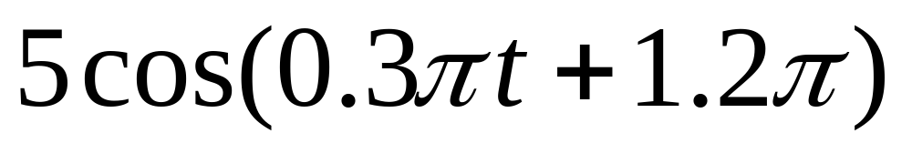
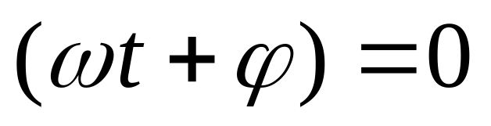
PLOTTING COSINE SIGNAL from the FORMULA
Determine period:
Determine a peak location by solving
Peak at t = -4
© 2003, JH McClellan & RW Schafer

Slide 6
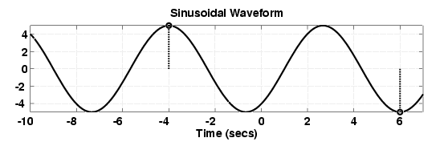
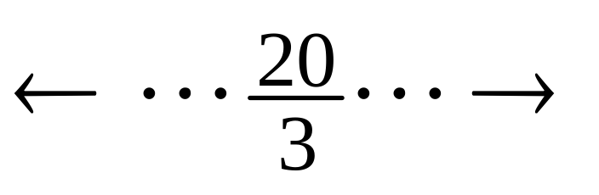
ANSWER for the PLOT
Use T=20/3 and the peak location at t=-4
© 2003, JH McClellan & RW Schafer

Slide 7
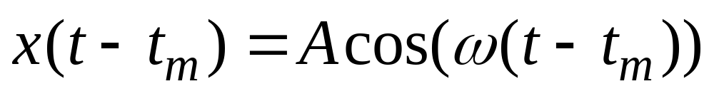
TIME-SHIFT
In a mathematical formula we can replace t with t-t_{m}
Then the t=0 point moves to t=t_{m}
Peak value of cos(ω(t-t_{m})) is now at t=t_{m}
© 2003, JH McClellan & RW Schafer

Slide 8
TIME-SHIFTED SINUSOID
© 2003, JH McClellan & RW Schafer

Slide 9
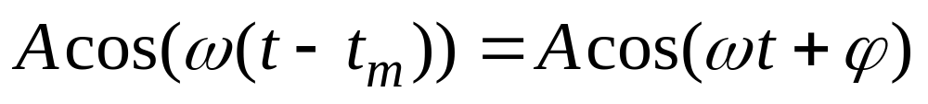
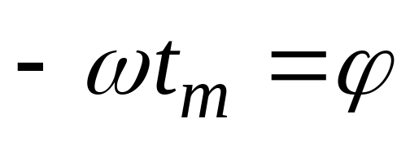
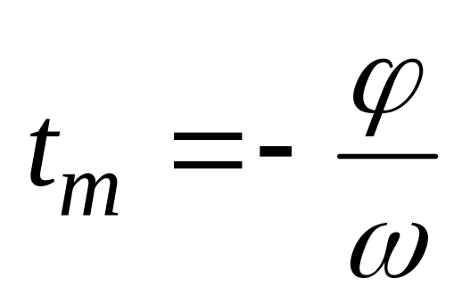
PHASE <-> TIME-SHIFT
Equate the formulas:
and we obtain:
or,
© 2003, JH McClellan & RW Schafer

Slide 10
SINUSOID from a PLOT
Measure the period, T
  Between peaks or zero crossings
  Compute frequency: ω = 2π/T
Measure time of a peak: t_{m}
  Compute phase: φ = -ω t_{m}
Measure height of positive peak: A
3 steps
© 2003, JH McClellan & RW Schafer

Slide 11
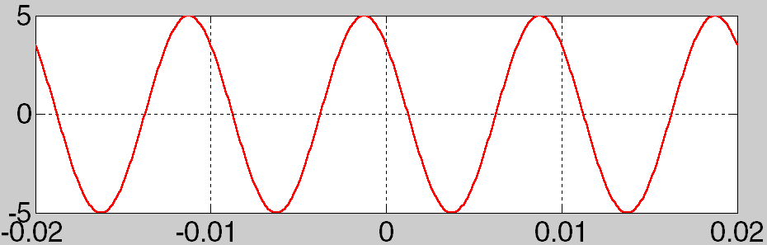
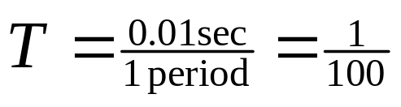
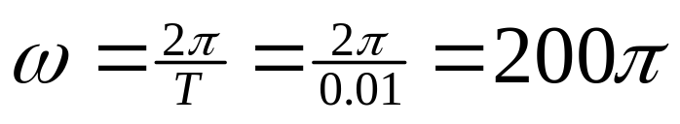
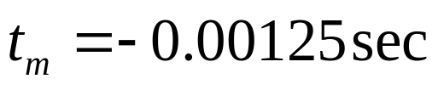
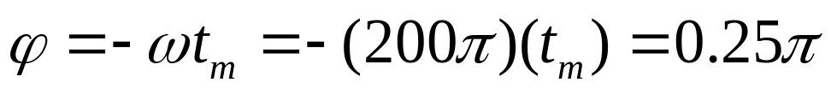
(A, ω, φ) from a PLOT
© 2003, JH McClellan & RW Schafer

Slide 12
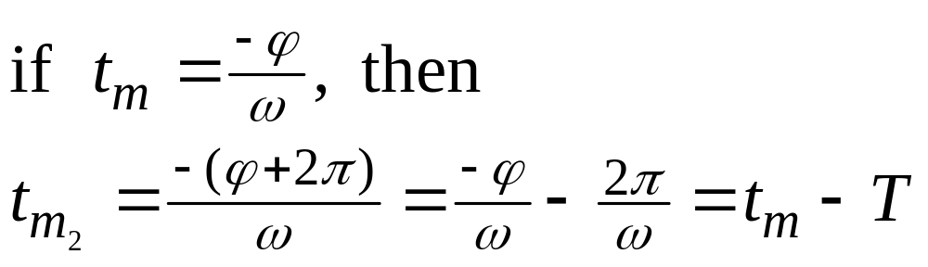
PHASE is AMBIGUOUS
The cosine signal is periodic
  Period is 2π
  Thus adding any multiple of 2π leaves x(t) unchanged
© 2003, JH McClellan & RW Schafer

Slide 13
COMPLEX NUMBERS
To solve: z² = -1
  z = j
  Math and Physics use z = i
Complex number: z = x + j y
y
z
Cartesian
coordinate
system
x
© 2003, JH McClellan & RW Schafer

Slide 14
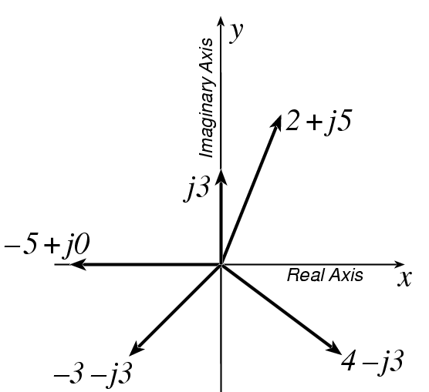
PLOT COMPLEX NUMBERS
© 2003, JH McClellan & RW Schafer

Slide 15
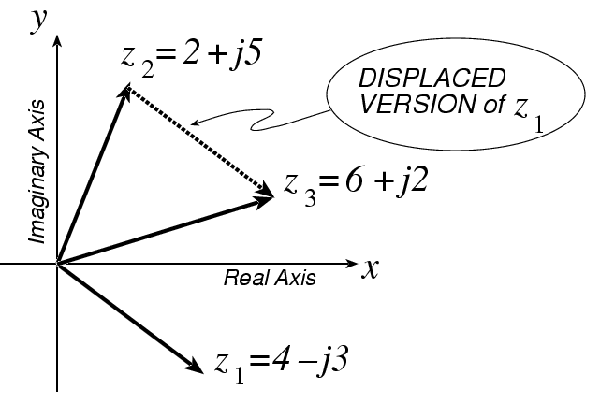
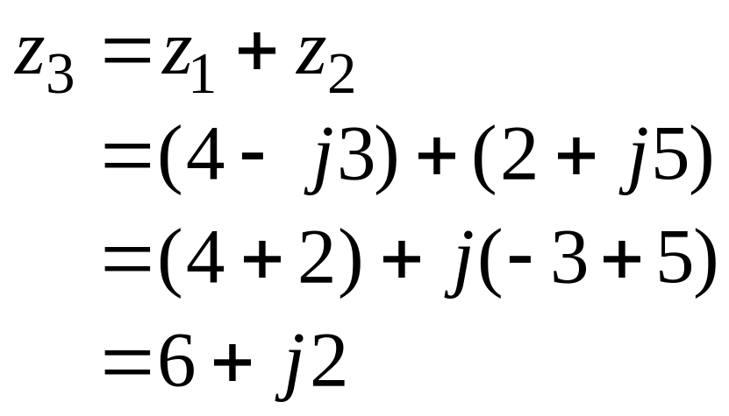
COMPLEX ADDITION = VECTOR Addition
© 2003, JH McClellan & RW Schafer

Slide 16
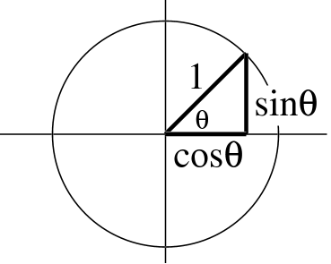
*** POLAR FORM ***
Vector Form
  Length =1
  Angle = θ
Common Values
    j has angle of 0.5π
    −1 has angle of π
    − j has angle of 1.5π
    also, angle of −j could be −0.5π = 1.5π −2π
    because the PHASE is AMBIGUOUS
© 2003, JH McClellan & RW Schafer

Slide 17

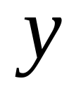
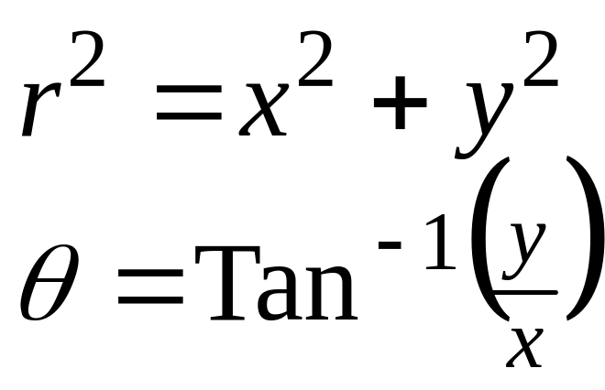

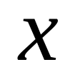
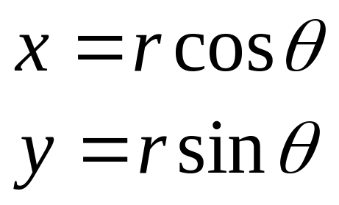
POLAR <-> RECTANGULAR
Relate (x,y) to (r,θ)
Most calculators do
Polar-Rectangular
Need a notation for POLAR FORM
© 2003, JH McClellan & RW Schafer

Slide 18
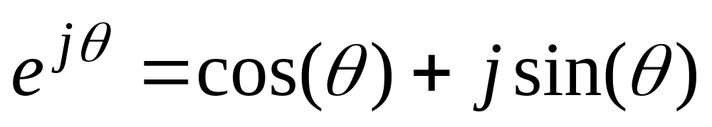
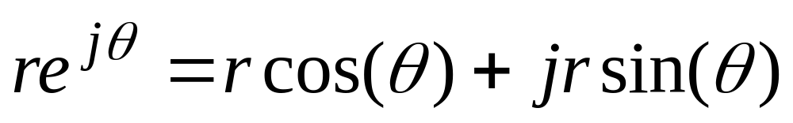
Euler’s FORMULA
Complex Exponential
  Real part is cosine
  Imaginary part is sine
  Magnitude is one
© 2003, JH McClellan & RW Schafer

Slide 19
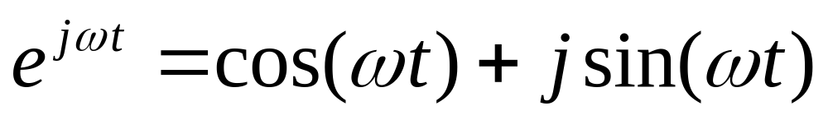

COMPLEX EXPONENTIAL
Interpret this as a Rotating Vector
  θ = ωt
  Angle changes vs. time
  ex: ω=20π rad/s
  Rotates 20π(10 rotations)
  in 1 secs
© 2003, JH McClellan & RW Schafer

Slide 20
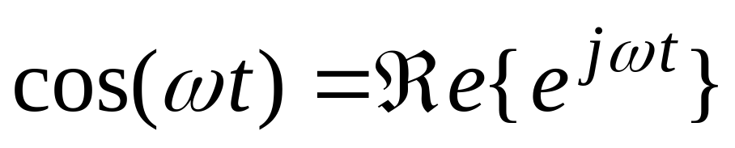
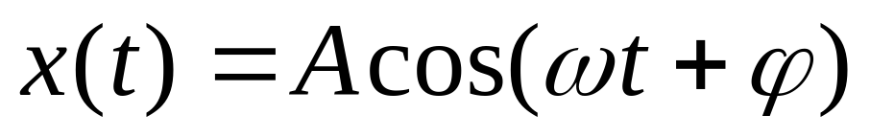
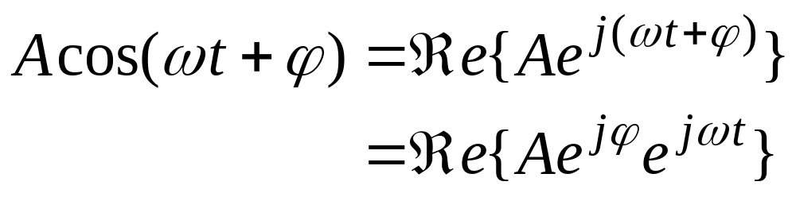
cos = REAL PART
Real Part of Euler’s
General Sinusoid
So,
© 2003, JH McClellan & RW Schafer

Slide 21
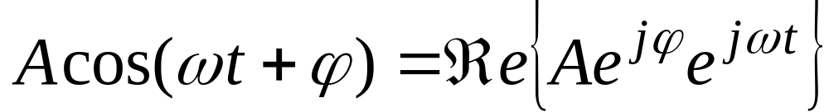
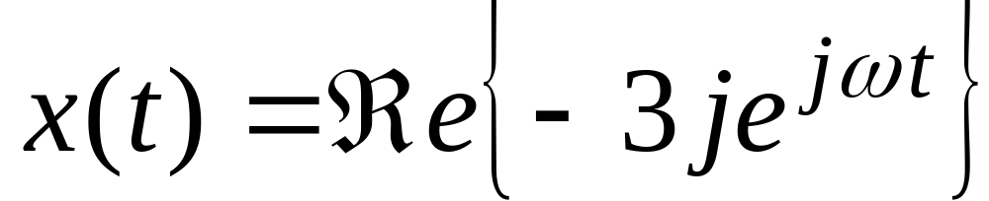
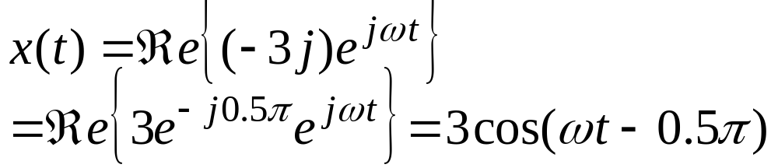
REAL PART EXAMPLE
Evaluate:
Answer:
© 2003, JH McClellan & RW Schafer

Slide 22
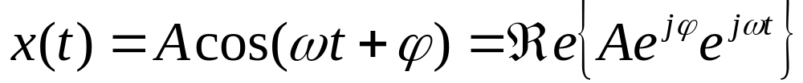
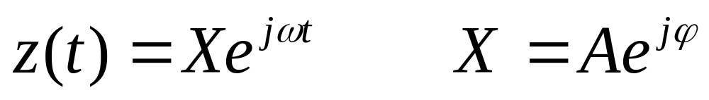
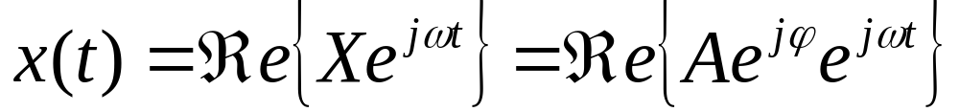
COMPLEX AMPLITUDE
General Sinusoid
Complex AMPLITUDE = X
Then, any Sinusoid = REAL PART of Xe^{jωt}
© 2003, JH McClellan & RW Schafer

